Slide 1
The Talk Between Computer and myRIO
Yu-Hao Peng

Slide 2
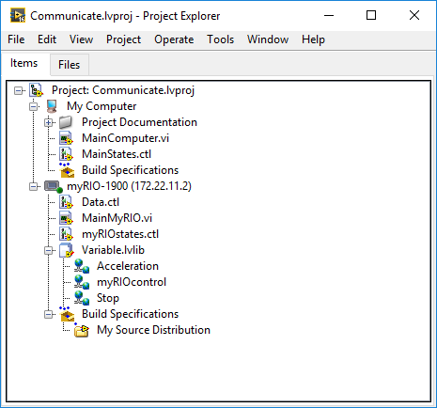
Project Explorer
Main VI on the Computer
Main VI on the myRIO
Share Variable: The myRIO and computer exchange data via share variable
My Computer
myRIO
Source Distribution: that package LabVIEW source files, which can be distributed to other LabVIEW developers or deployed to target

